Slide 1
SDU Drone Center Introduction to Drone Technology (IDT Fall 2024)
Course notes, module 6
UAV attitude failure detection
Ivan Panov ivan.panov@btech.au.dk

Slide 2
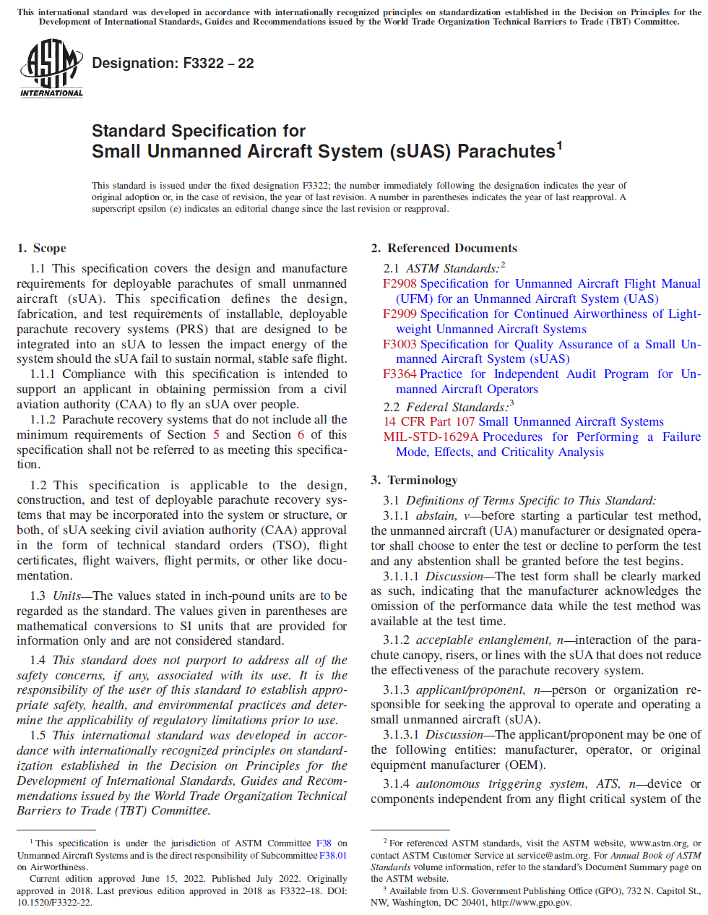
SDU Drone Center Introduction to Drone Technology (IDT Fall 2024)
The topic of this module is the basic principles of UAV attitude failure detection. The F3322-22 standard specification is paramount in relation to this, as it is an industrial standard to deal with the requirements of a Parachute Recovery System (PRS).

Slide 3
SDU Drone Center Introduction to Drone Technology (IDT Fall 2024)
F3322-22 standard. Scope.
Q1. How does compliance with this specification support obtaining permission from civil aviation authorities to fly over people?
Q2. In what units are the values stated for the design and testing of parachute recovery systems, and how are they converted to other measurement systems?
Q3. Does the standard address a comprehensive set of safety concerns?

Slide 4
SDU Drone Center Introduction to Drone Technology (IDT Fall 2024)
F3322-22 standard. Terminology.
Q4. What is an autonomous triggering system and how does it work?
Q5. What is a critical number motor failure (CNMF)?
Q6. What is a flight envelope?
Q7. What is a flight termination system?
Q8. What is a manual triggering device?
Q9. What is an opening shock load?
Q10. What is a parachute maximum dynamic shock load?
Q11. What is a pilot chute?
Q12. What is a snatch force?

Slide 5
SDU Drone Center Introduction to Drone Technology (IDT Fall 2024)
F3322-22 standard. Design Standards for Deployable Parachutes.
Q13. Explain the Main Canopy Rate of Descent Calculation equation (for a specific altitude).
Q14. Is it allowed to feed the PRS by the power supply of UAs?
Q15. Why is the Flight Termination System (FTS) obligatory onboard?
Q16. When shall the FTS be activated?
Q17. In what cases is a manual triggering device obligatory, and what are the exceptions?

Slide 6
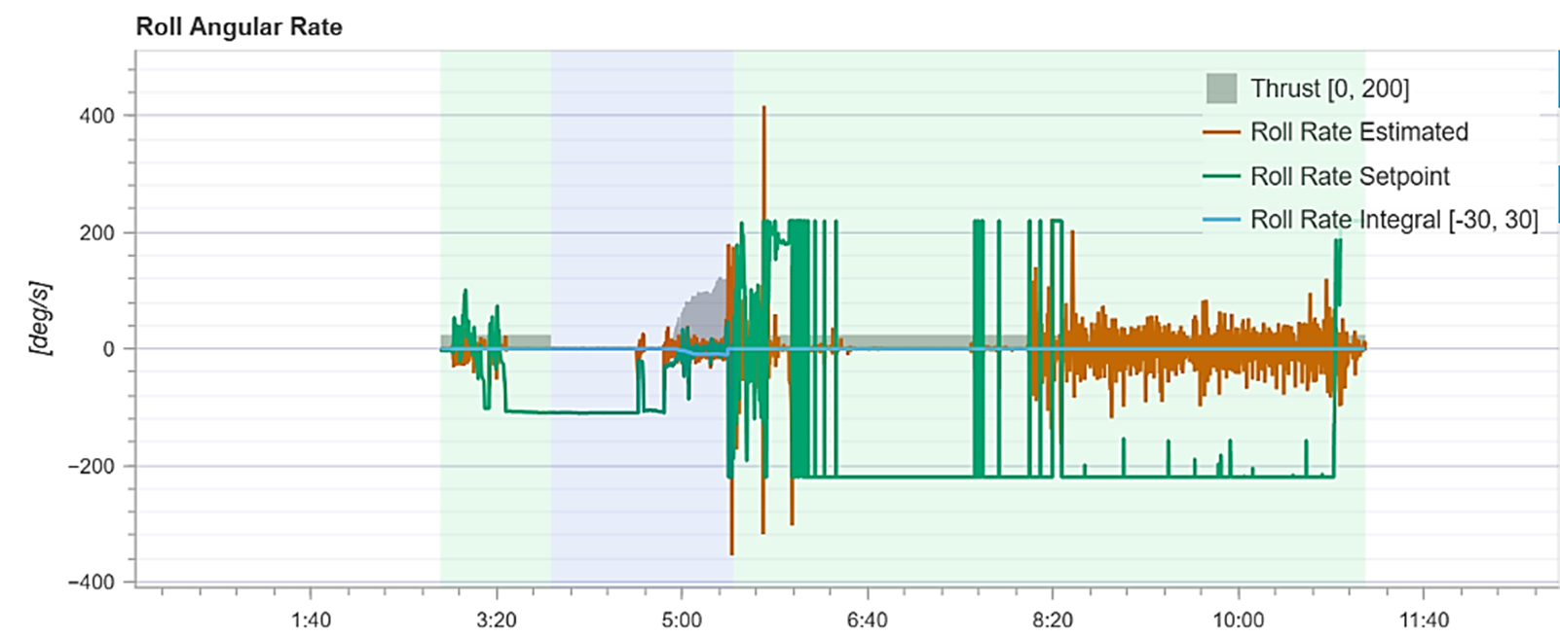
SDU Drone Center Introduction to Drone Technology (IDT Fall 2024)
PID Analysis
Pitch Rate Estimated (Orange Line): This line shows the estimated pitch rate, reflecting real-time measurements of how quickly the pitch angle changes.
Pitch Rate Setpoint (Green Line): The setpoint is the desired pitch rate, representing the target rate that the control system aims to achieve.
Upload .ulg files here: https://logs.px4.io

Slide 7
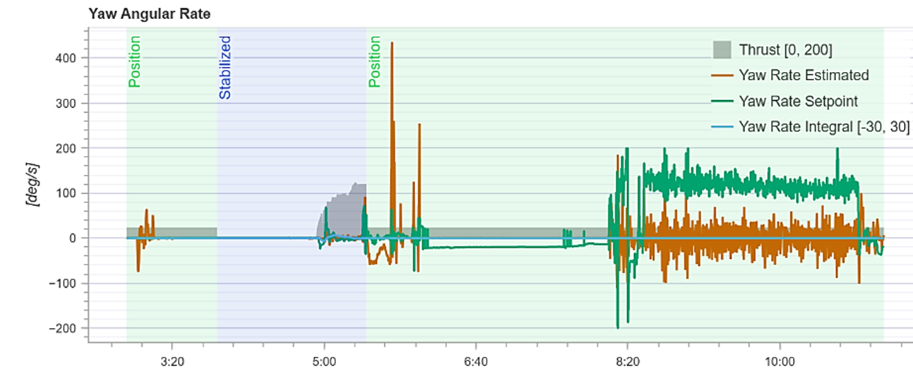
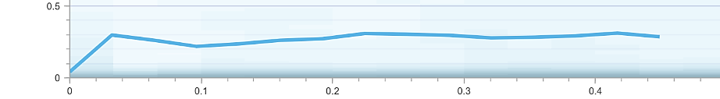
SDU Drone Center Introduction to Drone Technology (IDT Fall 2024)
PID Analysis
Strength (Vertical Axis): This axis shows the normalized output response strength. It indicates the magnitude of the yaw rate relative to the expected or commanded value.
Yaw Response Line (Blue Line): This line represents how the yaw rate changes in response to the step input over time.

Slide 8
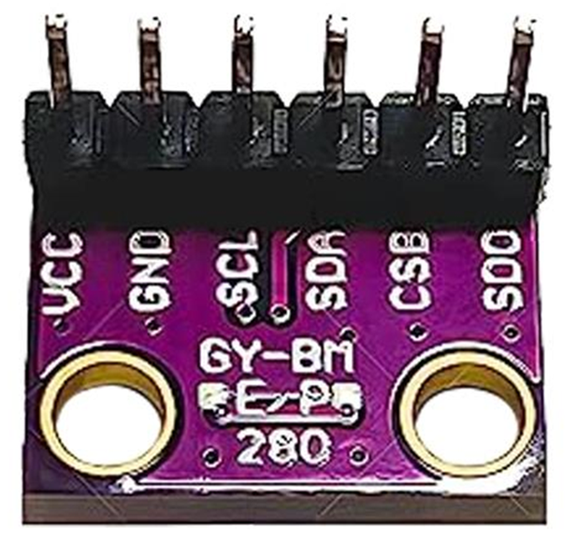
SDU Drone Center Introduction to Drone Technology (IDT Fall 2024)
- Barometer
Microelectromechanical systems (MEMS) barometers are tiny devices, typically ranging from 1 to 100 micrometers (0.001 to 0.1 mm) in size. Their small size, low power consumption, and high sensitivity make them ideal for UAV applications, where compact and lightweight components are crucial.
They work by measuring atmospheric pressure and temperature to calculate altitude.
The barometer calculates altitude using the principle that atmospheric pressure decreases with altitude. The sensor uses a formula based on the International Standard Atmosphere (ISA) model, which defines the relationship between altitude and atmospheric pressure. With this model, the barometer converts pressure data into a corresponding altitude reading.
Altitude calculation using a barometer relies on a reference pressure (typically set at ground level or take-off point).
More details: link

Slide 9
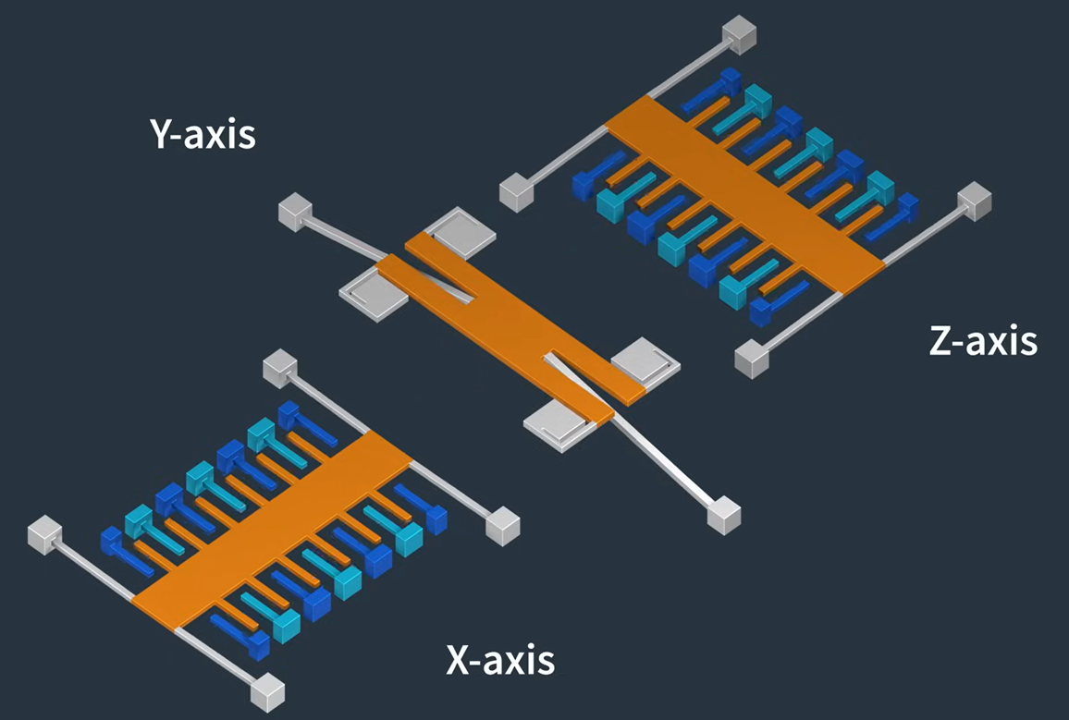
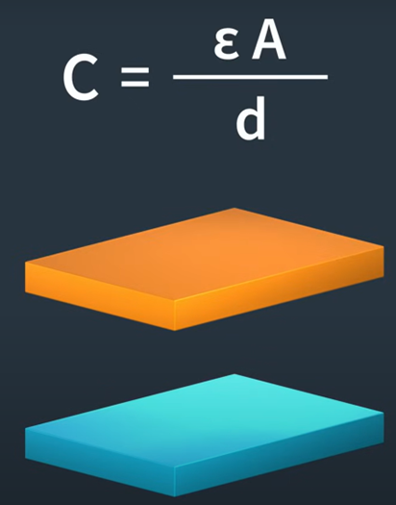
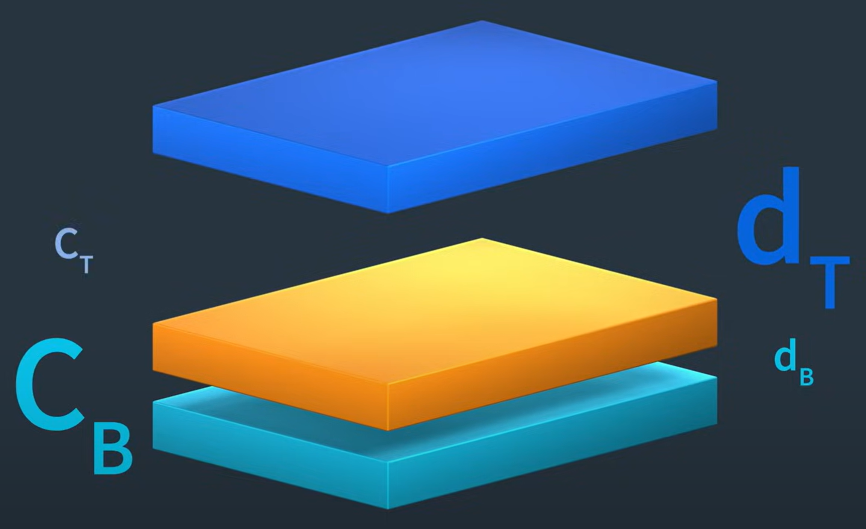
SDU Drone Center Introduction to Drone Technology (IDT Fall 2024)
- Accelerometer
C - the capacitance
ε - the constant permittivity (how well dielectric material stores an electric field)
A - the area of the plates
d - the distance between the plates
Source: www.youtube.com/watch?v=KuekQ-m9xpw

Slide 10
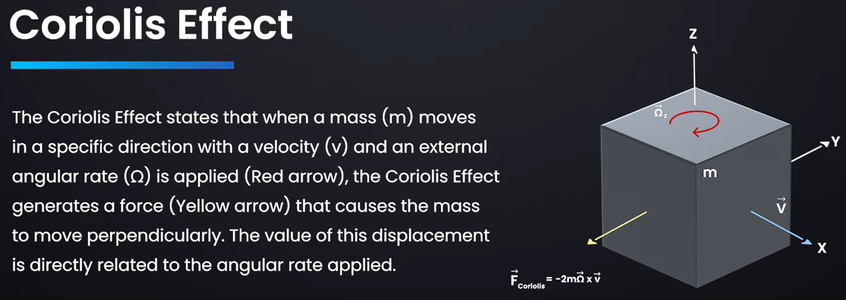
SDU Drone Center Introduction to Drone Technology (IDT Fall 2024)
How Gyroscope Sensor Works ?
Source: www.youtube.com/watch?v=REVp33SwwHE

Slide 11
SDU Drone Center Introduction to Drone Technology (IDT Fall 2024)
How Gyroscope Sensor Works ?
A gyroscope sensor is able to sense a drone's rotation even when the drone's velocity is zero. This is because the gyroscope is designed to detect angular velocity, which refers to the rate of rotation around an axis (yaw, pitch, or roll).
The key detail is that the gyroscope does not require the drone itself to be moving linearly (i.e., have velocity) for it to detect rotation. The sensor measures changes in angular velocity regardless of the drone's linear movement.
The internal structure of the gyroscope, especially in MEMS-based systems, involves oscillating masses. When the drone rotates (even if it is stationary), these oscillating masses experience a Coriolis force that is caused by the rotational movement. This force is then translated into a signal that the gyroscope uses to determine the rate and direction of rotation.

Slide 12
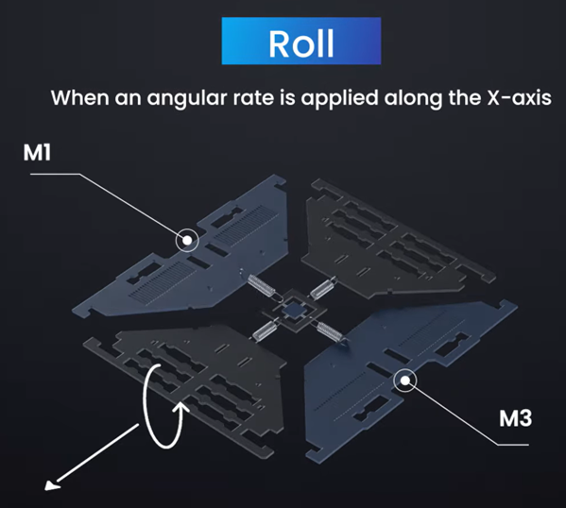
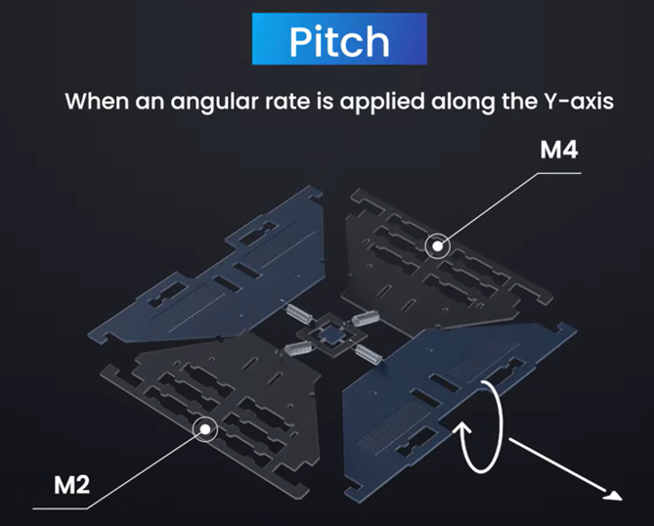
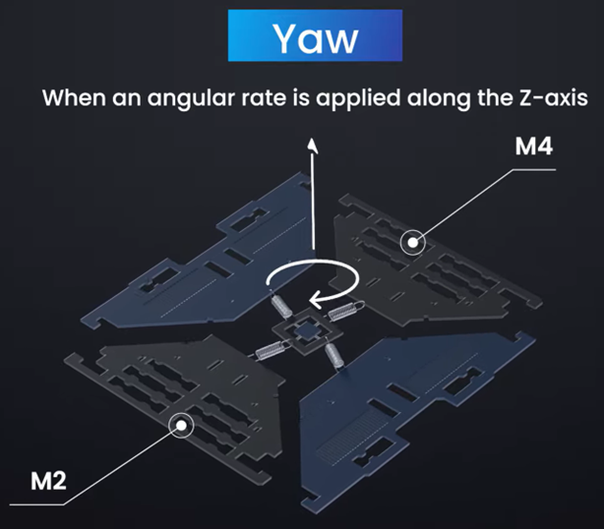
SDU Drone Center Introduction to Drone Technology (IDT Fall 2024)
How Gyroscope Sensor Works ?
Whenever the Coriolis effect is detected, the constant motion of the driving mass will cause a change in capacitance (ΔC) that is detected by the sensing structure and converted into a voltage signal.
Source: www.youtube.com/watch?v=REVp33SwwHE

Slide 13

SDU Drone Center Introduction to Drone Technology (IDT Fall 2024)
Future Gyroscope Sensors
Source: youtu.be/V6XSsNAWg00?t=603

Slide 14
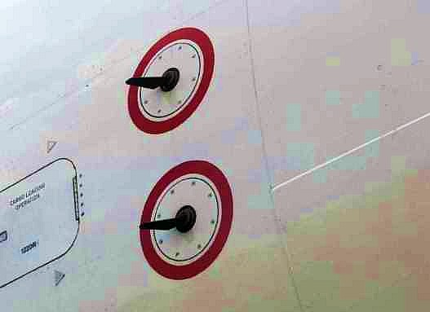
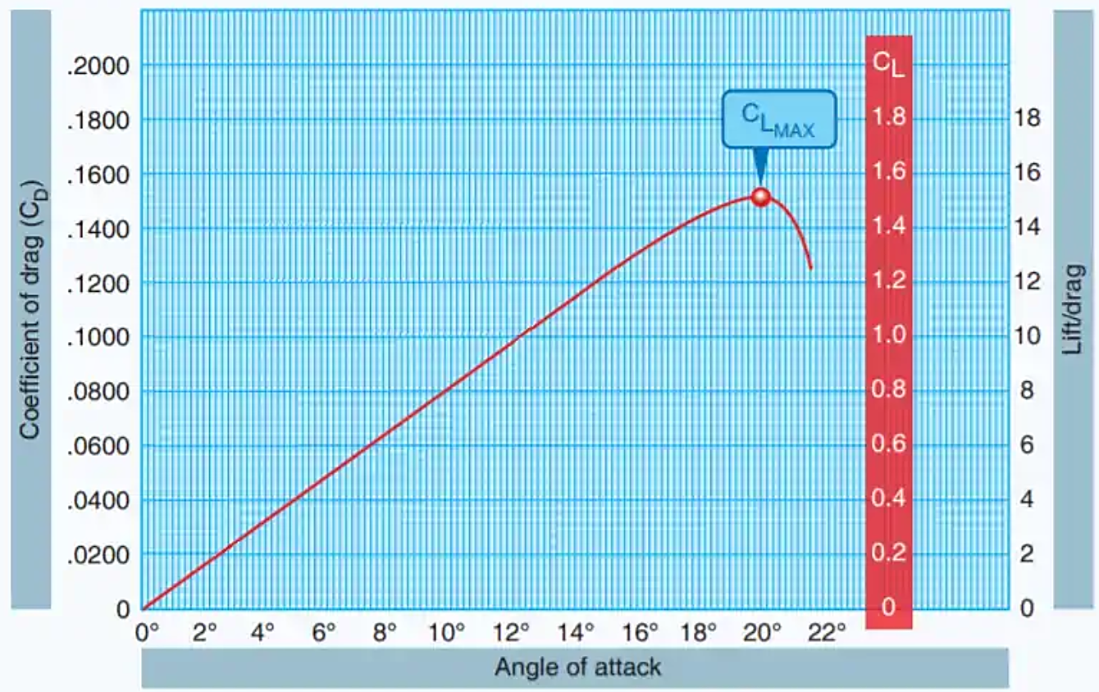
SDU Drone Center Introduction to Drone Technology (IDT Fall 2024)
Angle of attack (AoA) sensor
AoA sensors measure the angle between the wing's chord line and the oncoming airflow to indicate if an aircraft is approaching its critical angle, where a stall occurs due to disrupted airflow and loss of lift. When this critical AoA is detected, the system alerts the pilot with visual, auditory, or tactile warnings, prompting immediate corrective action. Modern aircraft may also use this data to activate automated stall protection measures. Multiple sensors ensure reliability, with pilots trained to integrate AoA readings with other flight data to maintain safe operations.

